Slide 1
Introduction Data Analytics
Data Analytics - WQD 7003
Dr. Ibrahim Abaker

Slide 2
Learning Outcomes
At the end of the class, students are able to:
Explain the basic concepts of data analytics

Slide 3
DATA ANALYTICS:
Data Analytics (DA): is the science of examining row data with the purpose of drawing conclusions about the information.
Often involves studying past historical data to:
Research potential trends
Analysis the effects of certain decisions or events, or
Evaluate the performance of a given tools or scenario
Goal: To improve the business by gaining knowledge which can be used to make improvements

Slide 4
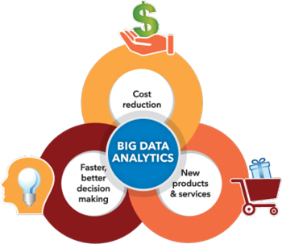
WHY DO WE NEED DATA ANALYTICS

Slide 5
ACTIVITIES IN DATA ANALYTICS
Foremost, bring the data in the environment.
Tidy the data, such that each column is a variable and each row is an observation.
Transform the data, includes narrowing observations of interest.
Visualize the data, to explore possible relationships
Models are complementary tools to visualization.
Communicate the results

Slide 6
Concepts and Terminology
Data Science: Is the professional field that deals with turning data into value, such as new insights or predictive models.
Data Mining: defined as the process of discovering patterns in data.
Machine Learning: Is a type of artificial intelligent (AI) that provides computers with the ability to learn without being explicitly programmed.
Datasets
Collections or groups of related data are generally referred to as datasets.
Each group or dataset member shares the same set of attributes or properties as others in the same dataset.
Examples:
Tweets stored in a flat file
A collection of image files in a directory
An extract of rows from a database table stored in a CSV formatted file
Historical weather observations that are stored as XML files
Notes:
Data Science: brings together expertise from fields including statistics, mathematics, computer science, communication as well as domain expertise such as business knowledge.
Machine learning focuses on the development of the computer programs that can change when exposed to new data.

Slide 7
Concepts and Terminology- cont’d
Algorithms: Algorithm is a set of steps for a computer program to accomplish a tasks.
Business Intelligence (BI): is a technology-driven process for analyzing data and presenting actionable information to help make informed business decisions.
NoSQL database: provides a mechanism for storage and retrieval of data that is modeled in means other than the tabular relations used in relational databases.
Data Warehouse: is a collection of corporate information and data derived from operational systems and external data sources.

Slide 8




The Model Has Changed…
The Model of Generating/Consuming Data has Changed
Old Model: Few companies are generating data, all others are consuming data
New Model: all of us are generating data, and all of us are consuming data

Slide 9
Business Intelligence vs. Data Science
Predictive Analytics & Data Mining (Data Science)
Typical Techniques & Data Types | Optimization, predictive modeling, forecasting, statistical analysis Structured/unstructured data, many types of sources, very large data sets
Common Questions | What if…..? What’s the optimal scenario for our business ? What will happen next? What if these trends continue? Why is this happening?
High
Data
Science
Business Intelligence
Typical Techniques & Data Types | Standard and ad hoc reporting, dashboards, alerts, queries, details on demand Structured data, traditional sources, manageable data sets
Common Questions | What happened last quarter? How many did we sell? Where is the problem? In which situations?
BUSINESS VALUE
Business
Intelligence
Low
Past
TIME
Future
Notes:
Business Intelligence (BI) focuses on using a consistent set of metrics to measure past performance and inform business planning. This includes creating Key Performance Indicators (KPIs) that reflect the most essential metrics to measure your business. Measures and KPIs are commonly defined within the OLAP schema to enable BI reporting on defined metrics.
Predictive Analytics & Data Mining (data science) refers to a combination of analytical and machine learning techniques used for drawing inferences and insight out of data. These methods include approaches such as regression analysis, Association Rules (for example, Market Basket Analysis), optimization techniques, and simulations (for example, Monte Carlo simulation to model scenario outcomes). These are the more robust techniques for answering higher order questions and deriving greater value for an organization.
Both BI and Data Mining are needed for organizations to meet these emerging business challenges successfully.

Slide 10
Business Drivers for Analytics
Current Business Problems Provide Opportunities for Organizations to Become More Analytical & Data Driven
Driver | Examples
Desire to optimize business operations | Sales, pricing, profitability, efficiency
Desire to identify business risk | Customer churn, fraud, default
Predict new business opportunities | Upsell, cross-sell, best new customer prospects
Comply with laws or regulatory requirements | Anti-Money Laundering, Fair Lending, Basel II
1
2
3
4
Notes:
Big data projects carry with them several considerations that you need to keep in mind to ensure this approach fits with what you are trying to achieve. Due of the characteristics of big data, these projects lend themselves to decision support for high-value, strategic decision making with high processing complexity. The analytic techniques being used in this context need to be iterative and flexible (analysis flexibility), due to the high volume of data and its complexity. These conditions give rise to complex analytical projects (such as predicting customer churn rates) that can be performed with some latency (consider the speed of decision making needed), or by operationalizing these analytical techniques using a combination of advanced analytical methods, big data and machine learning algorithms to provide real time (requires high throughput) or near real time analysis, such as recommendation engines that look at your recent web history and purchasing behavior.
In addition, to be successful you will need a different approach to the data architecture than seen in today’s typical EDWs. Analysts need to partner with IT and DBAs to get the data they need within an analytic sandbox, which contains raw data, aggregated data, and data with multiple kinds of structure. The sandbox requires a more savvy user to take advantage of it, and leverage it or exploring data in a more robust way.

Slide 11




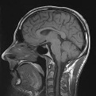


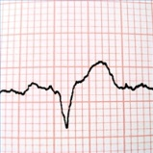









Opportunities for a New Approach to Analytics
MEASURED IN
TERABYTES
1TB = 1,000GB
MEASURED IN
PETABYTES
1PB = 1,000TB
WILL BE MEASURED IN
EXABYTES
1EB = 1,000PB
LARGE
VOLUME OF INFORMATION
SMALL
1990’s
(RDBMS & DATA WAREHOUSE)
2000’s
(CONTENT & DIGITAL ASSET MANAGEMENT)
2010’s
(NO-SQL & KEY/VALUE)

Slide 12
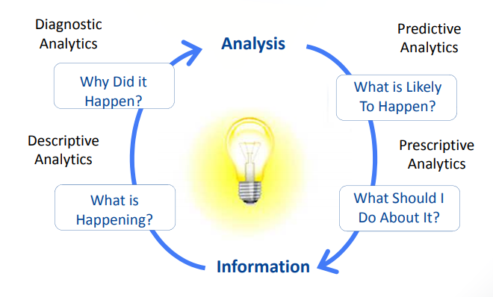
Examples of Big Data Analytics
Gartner

Slide 13
Predictive analytics
(What is likely to happen?)
To determine the outcome of an event that might occur in the future.
Generate knowledge that conveys how that information is related.
Form the basis of models that are used to generate future predictions based upon past events.
Sample questions:
What are the chances that a customer will default on a loan if they have missed a monthly payment?
What will be the patient survival rate if Drug B is administrated instead of Drug A?
If a customer has purchased Product A and B, what are the chances that they will also purchase Product C?
Predicts the outcomes of events and predictions are made on patterns, trends and exceptions found in historical and current data. This leads to the identification of both risks and opportunities.
Use of Large datasets comprised internal and external data and various data analysis techniques.
Greater value and required more skillset.
Statistical tools with user-friendly front-end interface.

Slide 14
Prescriptive Analytics
What Should I Do About It?
Build upon the results of predictive analytics by prescribing actions that should be taken.
Focus is not only on which prescribed option is best to follow, but why.
Provide results that can be reasoned about because they embed elements of situational understanding.
Can be used to gain an advantage or mitigate a risk.
Sample questions:
Among three drugs, which one provides the best results?
When is the best time to trade a particular stock?
Provide more value and require most advanced skillset and well as specialized software and tools.
Shift from explanatory to advisory. Simulation of various scenarios.
Incorporates internal and external data.
Internal data: customer information, current and historical sales data
External data: social media data, weather forecasts, and government –produced data.

Slide 15
Descriptive Analytics
What is Happening?
Answer questions about events that have already occurred.
Generate information
Sample questions:
What was the sales volume over the 12 months
What is the number of support calls received as categorized by severity and geographic location?
What is the monthly commission earned by each sales agent?
80% of generated analytics results are descriptive in nature
Least worth and require a relatively basic skillset.

Slide 16
Diagnostic Analytics
Why Did it Happen?
Determine the cause of a phenomenon that occurred in the past questions that focus on the reason behind the event.
Sample questions:
Why were Q2 sales less than Q1 sales?
Why have there been more support calls originating from the Eastern region than from the Western region?
Why was there an increase in patient re-admission rates over the past three months?
Provide more value than descriptive analytics but require a more advanced skillset.
Show trends and patterns—interactive visualization tools

Slide 17
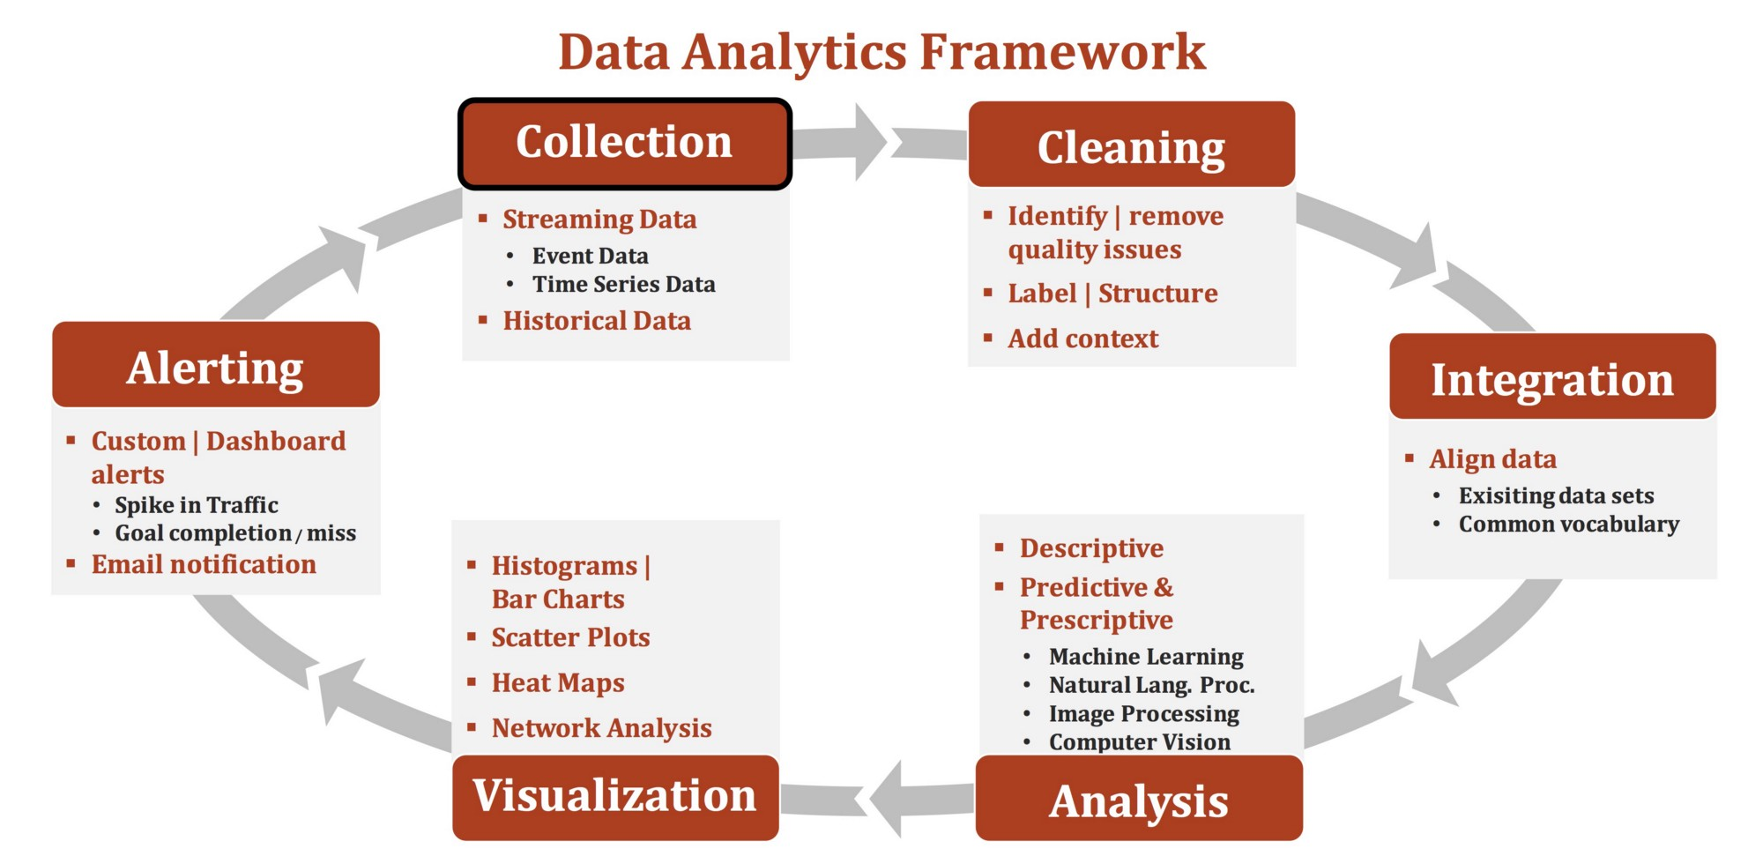
Data analytics framework

Slide 18
Question and Answer Session
Q & A

